Slide 1
Cyclistic
A bike-share company in Chicago.

Slide 2
A clear statement of the business task
Analyzing Bike usage of casual riders and annual members.
Understand differences and identify opportunities for conversion to maximize the annual memberships.

Slide 3
A description of all data sources used
Data is downloaded from divvy trip data between 2023-3 to 2024-2.
Rideable_type, member_casual, Started_at and ended_at are consistent.
Start and end station names, ids, and locations are not consistent.
Most of electric bikes customer's start and end station are not known.

Slide 4
Documentation of any cleaning or manipulation of data
Added new columns day_of_week and started_hour, extracting day of week from datetime by DAYOFWEEK and started_hour by HOUR SQL functions.
Added new calculated column named ride_length, calculated by TIMESTAMPDIFF and SEC_TO_TIME SQL functions.
Deleted all records where ride length were negative.

Slide 5
A summary of my analysis
While analyzing the data I discovered the following trends and surprises:
Casual riders average ride length are twice more than member riders.
Member riders didn't ride the docked-bike.
Member riders use more classic-bike compared to electric-bike.
Casual riders use more electric-bike compared to classic-bike.
May to September are the most Rides months.
Casual riders most rides are in weekend.
Member riders most rides are in working days.
In a day Member riders most rides took place around 8am and 4pm to 6pm, and for Casual riders around 4pm to 6pm.

Slide 6
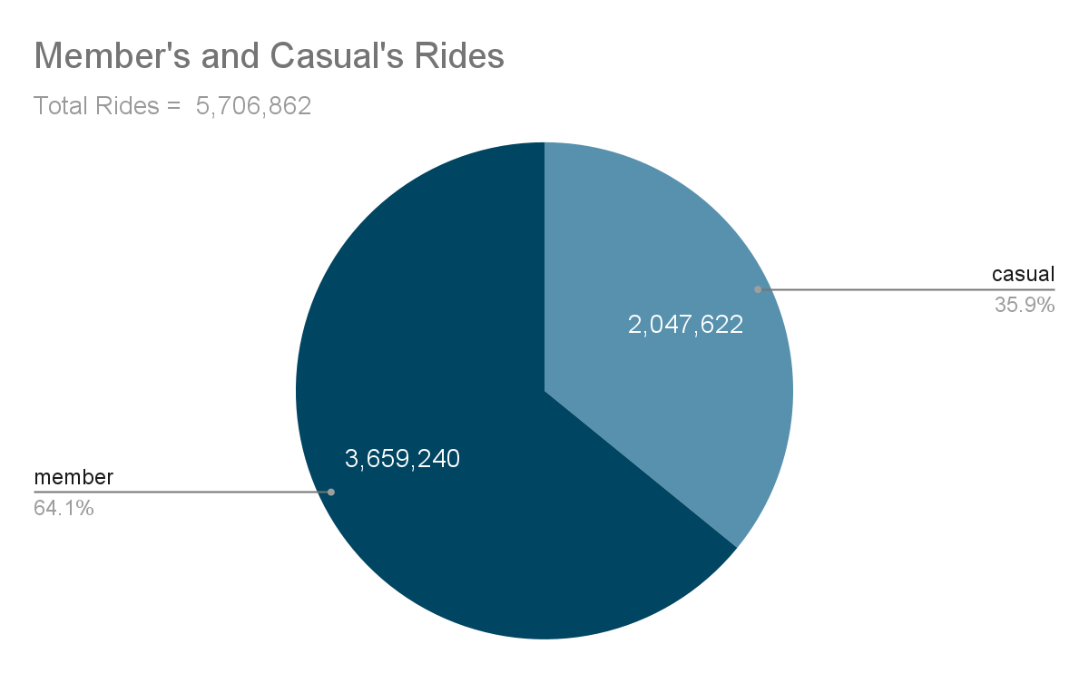
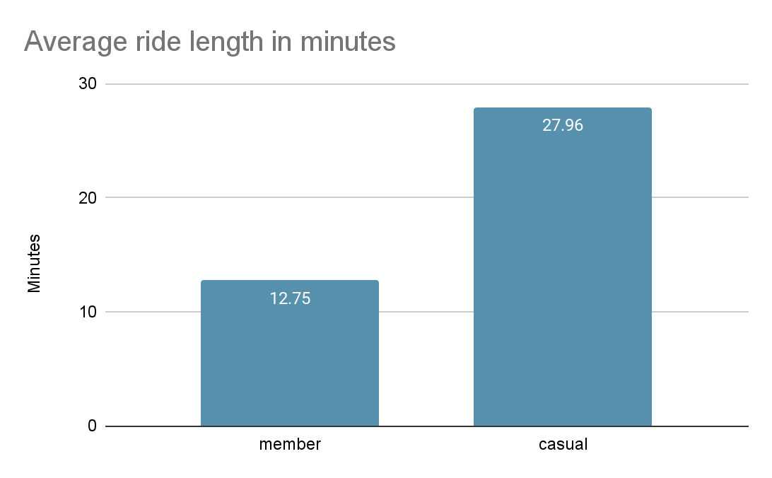
Supporting visualizations and key ﬁndings
Casual riders average ride length are twice more than member riders.

Slide 7
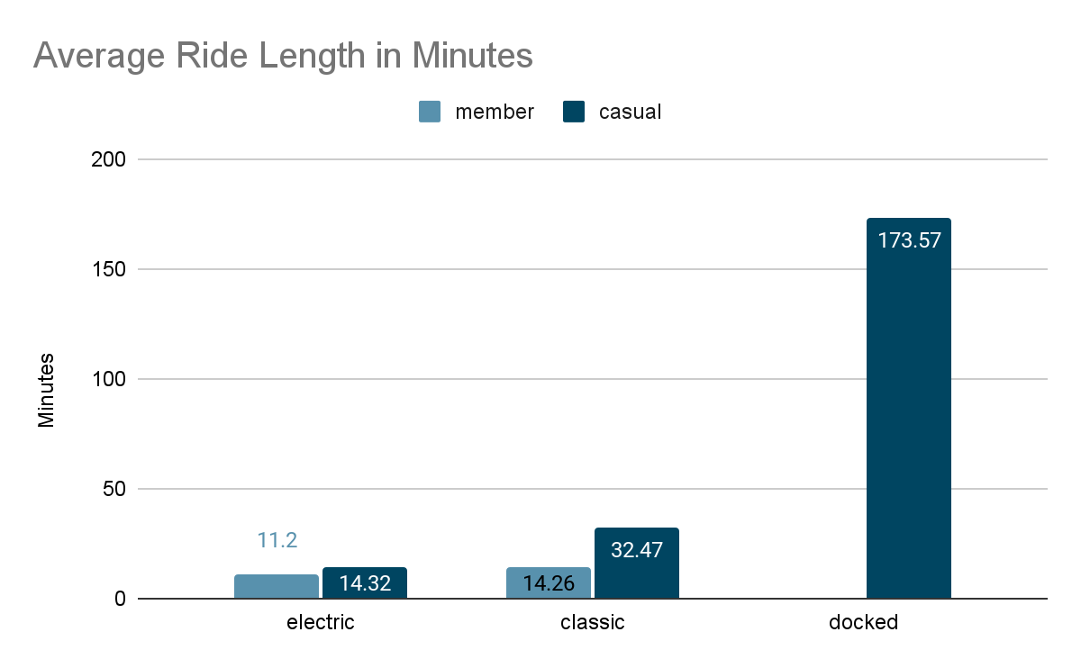
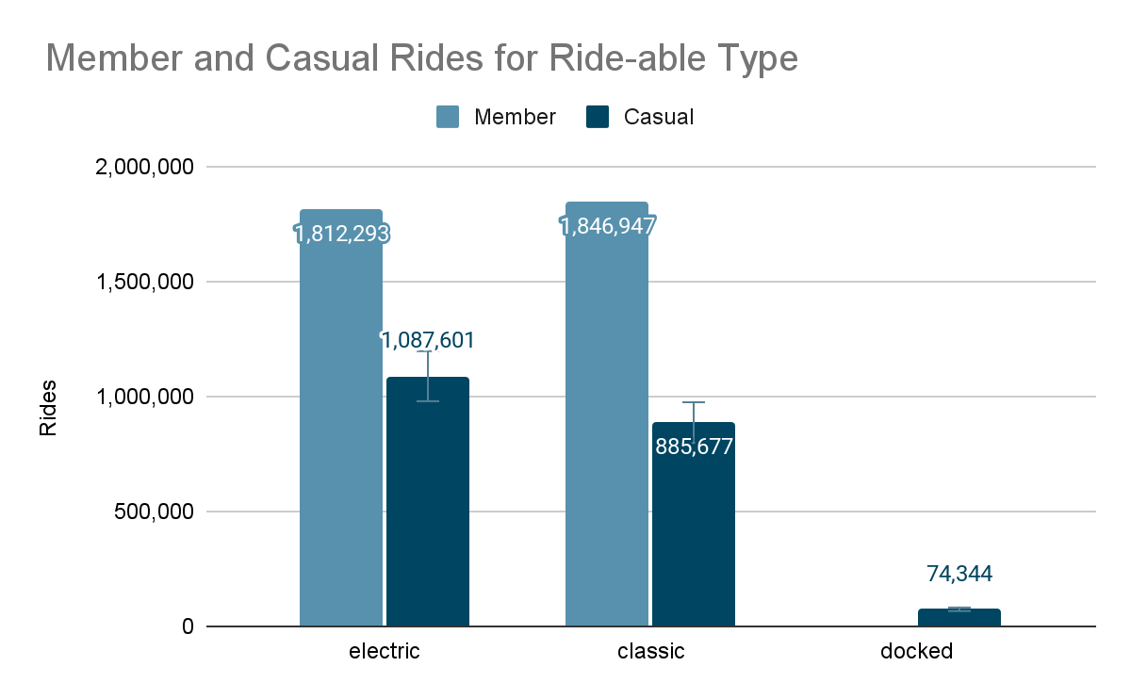
Supporting visualizations and key ﬁndings - cont
Member riders didn't ride the docked-bike yet.
Member riders use more classic-bike compared to electric-bike.
Casual riders use more electric-bike compared to classic-bike.

Slide 8
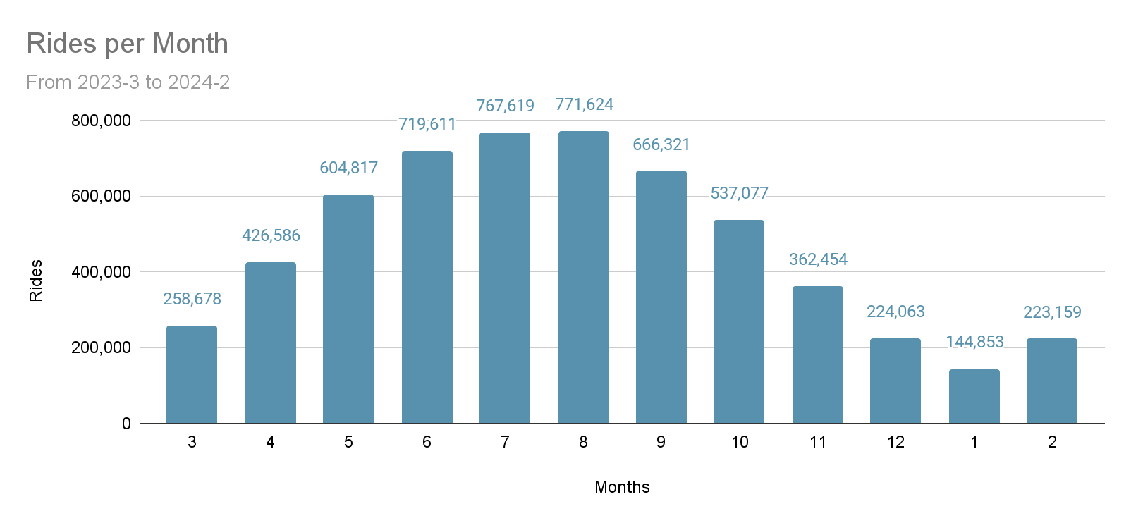
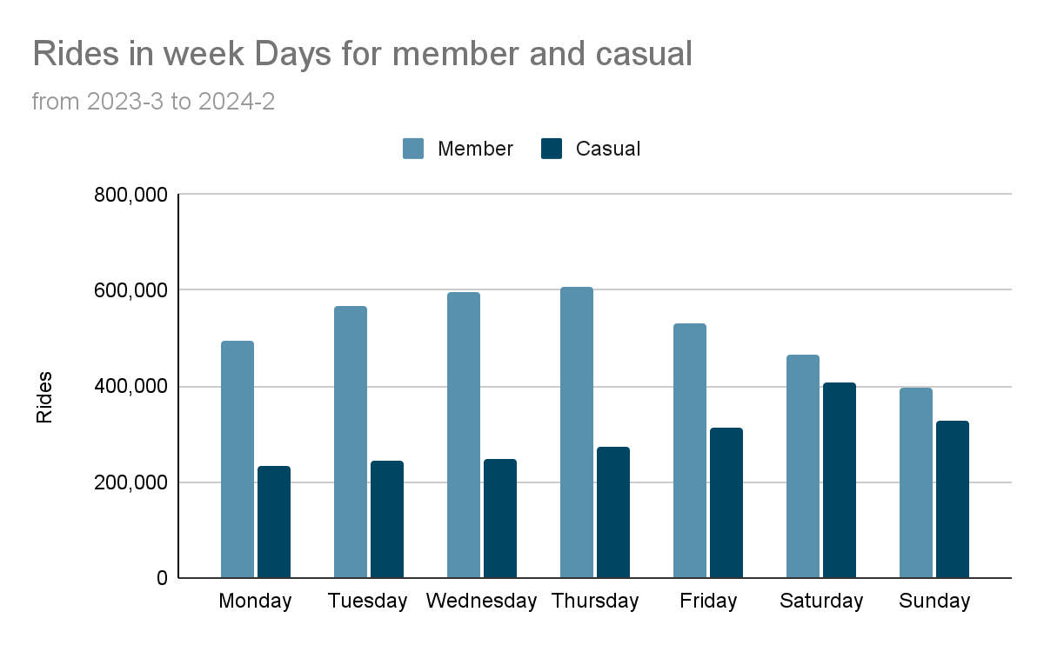
Supporting visualizations and key ﬁndings - cont
May to September are the most Rides months.
Casual riders most rides are in weekend.
Member riders most rides are in working days.

Slide 9
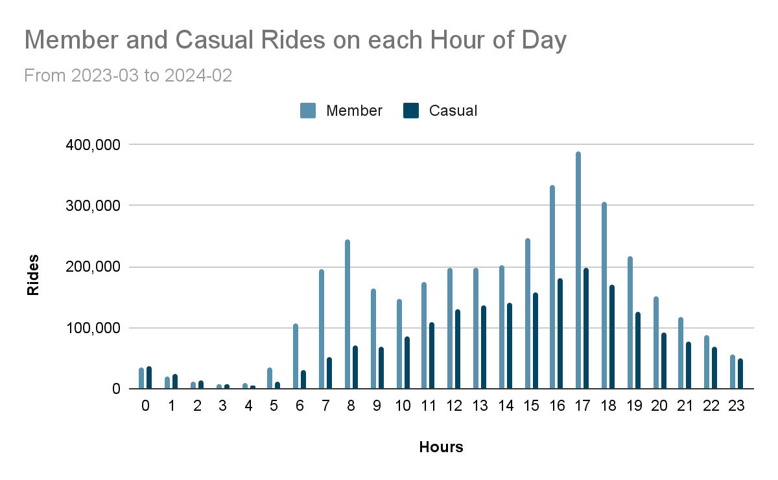
Supporting visualizations and key ﬁndings - cont
In each day Member riders most rides took place around 8am and 4pm to 6pm, and for Casual riders around 4pm to 6pm.

Slide 10
My top three recommendations based on my analysis
Create a campaign for summer to offer annual membership of electric-bike to casual riders.
Schedule the campaign around 8am and 5pm.
Target the audience who are currently casual riders and doing 9 to 5 job.

